Slide 1
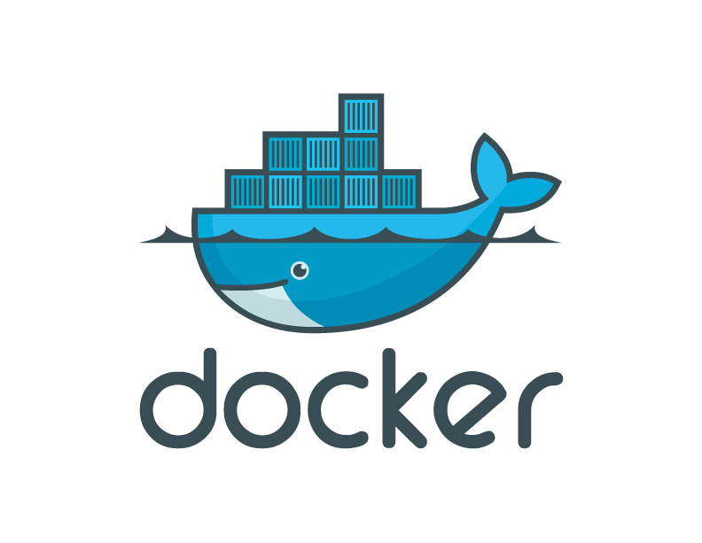
Docker, Containers, and the Future of Application Delivery

Slide 2
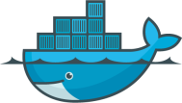
Contents
The challenge
The solution
Why Docker and Containers Matter?
How They Work?
Alternative/Complementary Approaches

Slide 3
Market View: Evolution of IT
1995
2015
Thin app on mobile, tablet
Thick, client-server app on thick client
Well-defined stack:
- O/S
- Runtime
- Middleware
Assembled by developers using best available services
Running on any available set of physical resources
(public/private/
virtualized)
Physical
Infrastructure

Slide 4
Challenges
2015
Thin app on mobile, tablet
Assembled by developers using best available services
How to ensure services interact consistently, avoid dependency hell
How to avoid n X n different configs
Running on any available set of physical resources
(public/private/
virtualized)
How to migrate & scale quickly, ensure compatibility

Slide 5

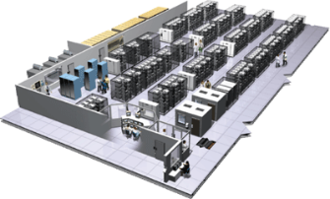
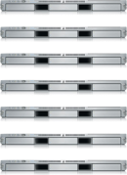
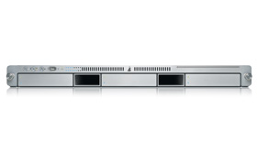
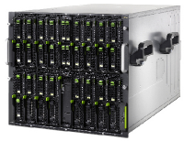
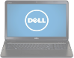
The Challenge
User DB
Static website
Queue
Analytics DB
Do services and apps interact appropriately?
Multiplicity of Stacks
Background workers
Web frontend
API endpoint
Production Cluster
Development VM
Public Cloud
Multiplicity of hardware environments
QA server
Can I migrate smoothly and quickly?
Disaster recovery
Customer Data Center
Contributor’s laptop
Production Servers

Slide 6
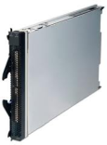
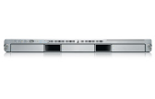
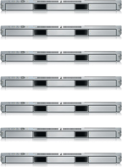

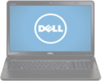
Results in N X N compatibility nightmare
? | ? | ? | ? | ? | ? | ?
? | ? | ? | ? | ? | ? | ?
? | ? | ? | ? | ? | ? | ?
? | ? | ? | ? | ? | ? | ?
? | ? | ? | ? | ? | ? | ?
? | ? | ? | ? | ? | ? | ?
Static website
Web frontend
Background workers
User DB
Analytics DB
Queue
 | Development VM | QA Server | Single Prod Server | Onsite Cluster | Public Cloud | Contributor’s laptop | Customer Servers

Slide 7
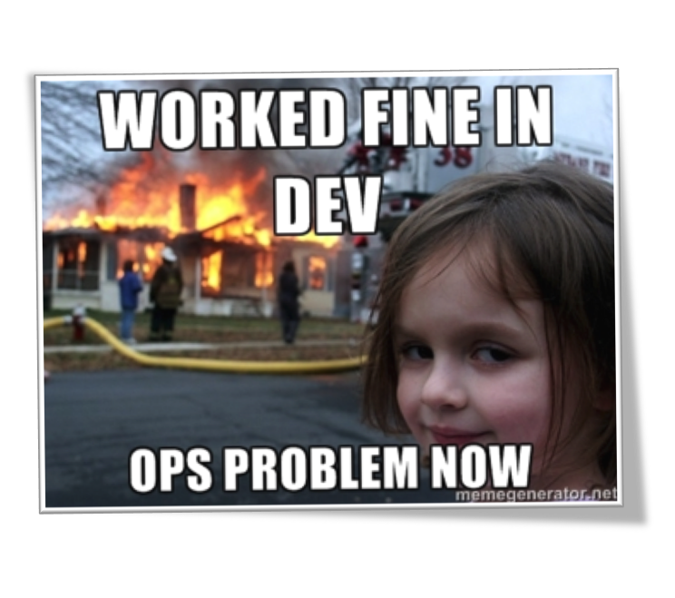

Slide 8
A useful analogy…

Slide 9
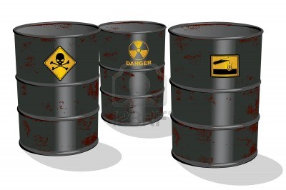
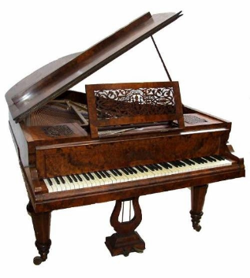

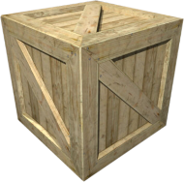
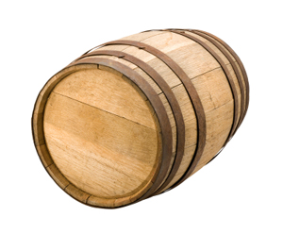
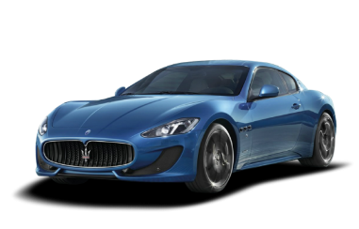
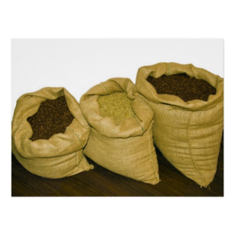



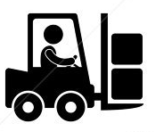
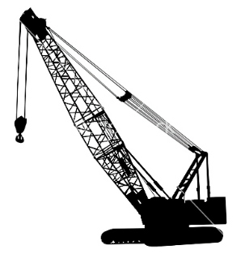
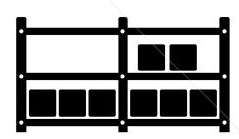

Cargo Transport Pre-1960
Do I worry about how goods interact (e.g. coffee beans next to spices)
Multiplicity of Goods
Multipilicity of methods for transporting/storing
Can I transport quickly and smoothly
(e.g. from boat to train to truck)

Slide 10
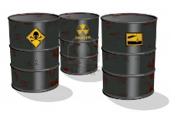




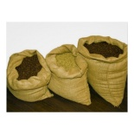


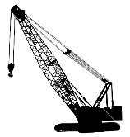



Also an NxN Matrix
 | ? | ? | ? | ? | ? | ? | ?
 | ? | ? | ? | ? | ? | ? | ?
 | ? | ? | ? | ? | ? | ? | ?
 | ? | ? | ? | ? | ? | ? | ?
 | ? | ? | ? | ? | ? | ? | ?
 | ? | ? | ? | ? | ? | ? | ?

Slide 11
Contents
The challenge
The solution
Why Docker and Containers Matter?
How They Work?
Alternative/Complementary Approaches

Slide 12

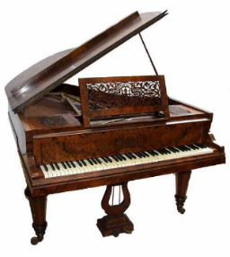

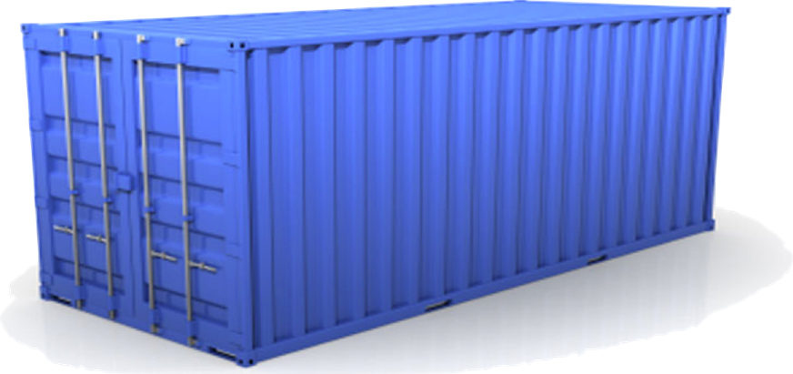
Solution: Shipping Container
Do I worry about how goods interact (e.g. coffee beans next to spices)
Multiplicity of Goods
A standard container that is loaded with virtually any goods, and stays sealed until it reaches final delivery.
…in between, can be loaded and unloaded, stacked, transported efficiently over long distances, and transferred from one mode of transport to another
Can I transport quickly and smoothly
(e.g. from boat to train to truck)
Multiplicity of methods for transporting/storing

Slide 13


This eliminated the NXN problem…

Slide 14
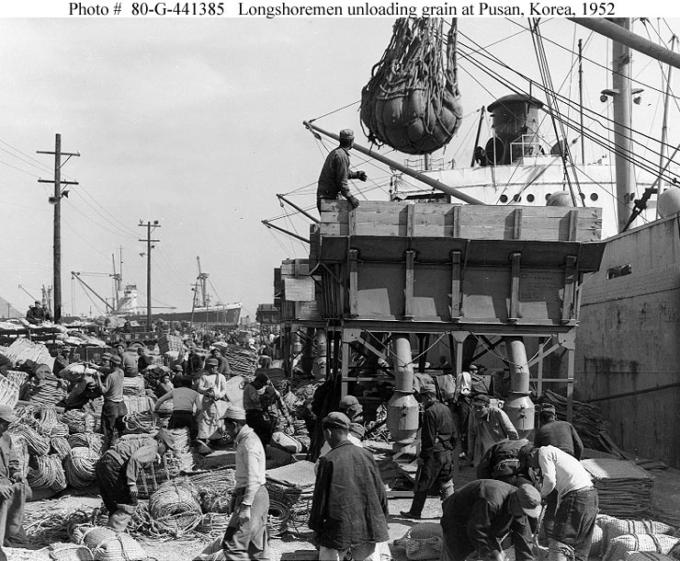
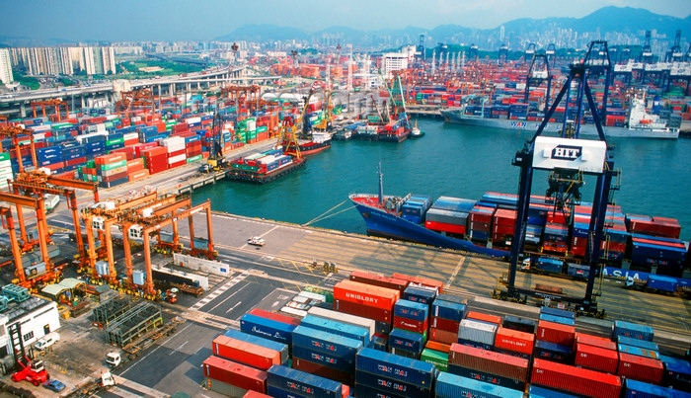
and spawned the Shipping Container Ecosystem
90% of all cargo now shipped in a standard container
Order of magnitude reduction in cost and time to load and unload ships
Massive reduction in losses due to theft or damage
Huge reduction in freight cost as percent of final goods (from >25% to <3%)
massive globalizations
5000 ships deliver 200M containers per year

Slide 15
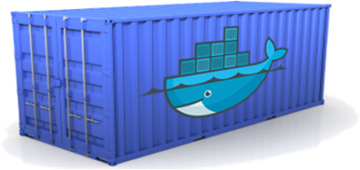
Docker is a shipping container system for code
Static website
User DB
Web frontend
Queue
Analytics DB
Do services and apps interact appropriately?
Multiplicity of Stacks
An engine that enables any payload to be encapsulated as a lightweight, portable, self-sufficient container…
…that can be manipulated using standard operations and run consistently on virtually any hardware platform
Multiplicity of hardware environments
Can I migrate smoothly and quickly
Development VM
QA server
Customer Data Center
Public Cloud
Production Cluster
Contributor’s laptop

Slide 16
Or…put more simply
Static website
User DB
Web frontend
Queue
Analytics DB
Do services and apps interact appropriately?
Multiplicity of Stacks
Developer: Build Once, Run Anywhere (Finally)
Operator: Configure Once, Run Anything
Multiplicity of hardware environments
Can I migrate smoothly and quickly
Development VM
QA server
Customer Data Center
Public Cloud
Production Cluster
Contributor’s laptop

Slide 17
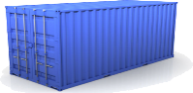
Docker solves the NXN problem
Static website
Web frontend
Background workers
User DB
Analytics DB
Queue
 | Development VM | QA Server | Single Prod Server | Onsite Cluster | Public Cloud | Contributor’s laptop | Customer Servers

Slide 18
Contents
The challenge
The solution
Why Docker and Containers Matter?
How They Work?
Alternative/Complementary Approaches

Slide 19
Why containers matter
 | Physical Containers | Docker
Content Agnostic | The same container can hold almost any type of cargo | Can encapsulate any payload and its dependencies
Hardware Agnostic | Standard shape and interface allow same container to move from ship to train to semi-truck to warehouse to crane without being modified or opened | Using operating system primitives can run consistently on virtually any hardware—VMs, bare metal, openstack, public IAAS, etc.—without modification
Content Isolation and Interaction | No worry about anvils crushing bananas. Containers can be stacked and shipped together | Resource, network, and content isolation. Avoids dependency hell
Automation | Standard interfaces make it easy to automate loading, unloading, moving, etc. | Standard operations to run, start, stop, commit, search, etc. Perfect for devops: CI, autoscaling, clouds
Highly efficient | No opening or modification, quick to move between endpoints | Lightweight, virtually no perf or start-up penalty, quick to move and manipulate
Separation of duties | Shipper worries about inside of box, carrier worries about outside of box | Developer worries about code. Ops worries about infrastructure.

Slide 20
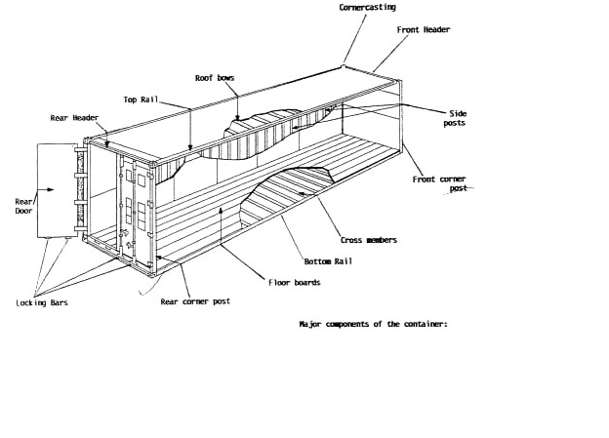
Why it works—separation of concerns
Dan the Developer
Worries about what’s “inside” the container
His code
His Libraries
His Package Manager
His Apps
His Data
All Linux servers look the same
Oscar the Ops Guy
Worries about what’s “outside” the container
Logging
Remote access
Monitoring
Network config
All containers start, stop, copy, attach, migrate, etc. the same way

Slide 21
Why Developers Care
Build once…run anywhere
A clean, safe and portable runtime environment for your app.
No worries about missing dependencies, packages and other pain points during subsequent deployments.
Take a snapshot of a running container and restore it again when required.
Run each app in its own isolated container, so you can run various versions of libraries and other dependencies for each app without worrying
Automate testing, integration, packaging…you can script anything
Reduce/eliminate concerns about compatibility on different platforms, datacenter (Gatineau, Borden, etc..)

Slide 22
Why Ops Cares?
Configure once…run anything
Make the entire lifecycle more efficient, consistent, and repeatable
Increase the quality of code produced by developers.
Eliminate inconsistencies between development, Test, QA, pre-prod and production environments
Support segregation of duties
Significantly improves the speed and reliability of continuous deployment and continuous integration systems
Because the containers are so lightweight, address significant performance, costs, deployment, and portability issues normally associated with VMs

Slide 23
Contents
The challenge
The solution
Why Docker and Containers Matter?
How They Work
Alternative/Complementary Approaches

Slide 24
Containers vs. VMs
App
A
App
A’
App
B
Containers are isolated,
but share OS and, where
appropriate, bins/libraries
Bins/
Libs
Bins/
Libs
Bins/
Libs
VM
Guest
OS
Guest
OS
Guest
OS
Guest
OS
Guest
OS
App A
App A’
App B
App B’
App B’
App B’
App B’
Container
Bins/Libs
Bins/Libs
Hypervisor (Type 2)
Docker Engine
Host OS
Host OS
Server
Server

Slide 25
What are the basics of the Docker system?
Container A
SSC’s
Docker
Container
Image Registry
Push
Search
Pull
Source Code Repository
Run
Build
Dockerfile
For
A
Container A
Container B
Container C
Docker Engine
Docker Engine
Host 1 OS (Linux)
Host 2 OS 2 (Linux)

Slide 26
Use Cases—From theCommunity
Use Case | Examples | Link
Clusters | Building a MongoDB cluster using docker | http://bit.ly/1acbjZf
 | Production Quality MongoDB Setup with Docker | http://bit.ly/15CaiHb
 | Wildfly cluster using Docker on Fedora | http://bit.ly/1bClX0O
Build your own PaaS | OpenSource PaaS built on Docker, Chef | http://deis.io
Web Based Environment for Instruction | JiffyLab – web based environment for the instruction, or lightweight use of, Python and UNIX shell | http://bit.ly/12oaj2K
Easy Application Deployment | Deploy Java Apps With Docker = Awesome | http://bit.ly/11BCvvu
 | How to put your development environment on docker | http://bit.ly/1b4XtJ3
 | Running Drupal on Docker | http://bit.ly/15MJS6B
 | Installing Redis on Docker | http://bit.ly/16EWOKh
Create Secure Sandboxes | Docker makes creating secure sandboxes easier than ever | http://bit.ly/13mZGJH
Create your own SaaS | Memcached as a Service | http://bit.ly/11nL8vh
Automated Application Deployment | Multi-cloud Deployment with Docker | http://bit.ly/1bF3CN6
Continuous Integration and Deployment | Next Generation Continuous Integration & Deployment with dotCloud’s Docker and Strider | http://bit.ly/ZwTfoy
 | Testing Salt States Rapidly With Docker | http://bit.ly/1eFBtcm
Lightweight Desktop Virtualization | Docker Desktop: Your Desktop Over SSH Running Inside Of A Docker Container | http://bit.ly/14RYL6x

Slide 27
Use Cases
Ted Dziuba on the Use of Docker for Continuous Integration at Ebay Now
https://speakerdeck.com/teddziuba/docker-at-ebay
http://www.youtube.com/watch?feature=player_embedded&v=0Hi0W4gX--4
Sasha Klizhentas on use of Docker at Mailgun/Rackspace
http://www.youtube.com/watch?feature=player_embedded&v=CMC3xdAo9RI
Sebastien Pahl on use of Docker at CloudFlare
http://www.youtube.com/watch?feature=player_embedded&v=-Lj3jt_-3r0
Cambridge HealthCare
http://blog.howareyou.com/post/62157486858/continuous-delivery-with-docker-and-jenkins-part-i
Red Hat Openshift and Docker
https://www.openshift.com/blogs/technical-thoughts-on-openshift-and-docker

Slide 28
Want to learn more?
www.docker.io:
Documentation
Getting started: interactive tutorial, installation instructions, getting started guide,
About: Introductory whitepaper: http://www.docker.io/the-whole-story/
Github: dotcloud/docker
IRC: freenode/#docker
Google groups: groups.google.com/forum/#!forum/docker-user
Twitter: follow @docker

